Slide 1
Best location for a Chinese restaurant in New York - IBM Capstone Project
Zhicheng Zhu

Slide 2
Introduction
1.1 Business Problem
New York is a city located in New York State, USA, and is the most populous city in the United States. In this project, we going to choose this city as an example to use data analyst skill I learnt in the IBM data science course. We intend to find the best place to open an Chinese restaurant in New York at Queens. The target audience could be the one who want to find a place to open the Chinese restaurant in New York. We will find the place without too much Chinese restaurant and also with enough people lives. To use k-means clustering and foursquare to analyze data and create maps and also use panda to import data.

Slide 3
Introduction
1.2Methodology
The purpose of the analysis is to highlight the best Chinese restaurant locations in order to provide entrepreneurs with valuable suggestions. To this end, we will use the machine learning K-Means algorithm to divide New York into several clusters and give a "scoring" form for developing restaurant business from the most interesting area to the least interesting area. But before that, we will first explore the downtown area of New York to get all the restaurant information (data) in the downtown area. This will help us easily highlight the most visited food districts.

Slide 4
Data Mining
2.1 Data Collection¶
All geographic coordinates of Queens, New York will be downloaded here: https://cf-courses-data.s3.us.cloud-object-storage.appdomain.cloud/IBMDeveloperSkillsNetwork-DS0701EN-SkillsNetwork/labs/newyork_data.json we will Create a table in which each region is listed as a row, and the longitude and latitude are listed as columns.
In the next step, we collect the locations of each department (listed in the table above) and look at the most common locations. In this step, we will use the Foursquare API to collect the name, category, GPS coordinates of all the data about the place. After collecting the data and sorting it into a panda data frame, we will get a table listing the top 10 locations for each department.
The final task is to use unsupervised machine learning techniques to cluster them according to the most common places, and use the Folio library to visualize all clusters.

Slide 5
Data Mining
After we use the data frame we found that, in Queens, there are currently 999 Chinese restaurants opens. So we need do next step to analyze data, and found at least top or top 10 position for our business.

Slide 6
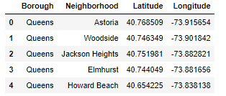
Data Mining
After we using API to search in Queens, we will find the top 5 location

Slide 7
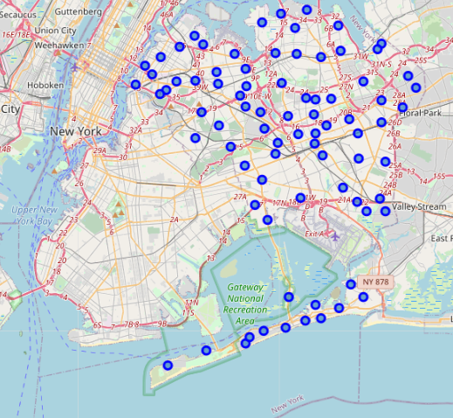
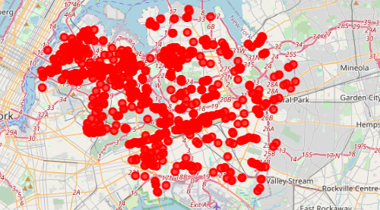
Data Mining
Then, foursquare will going to help us to find all kind of restaurant in all around the queens

Slide 8
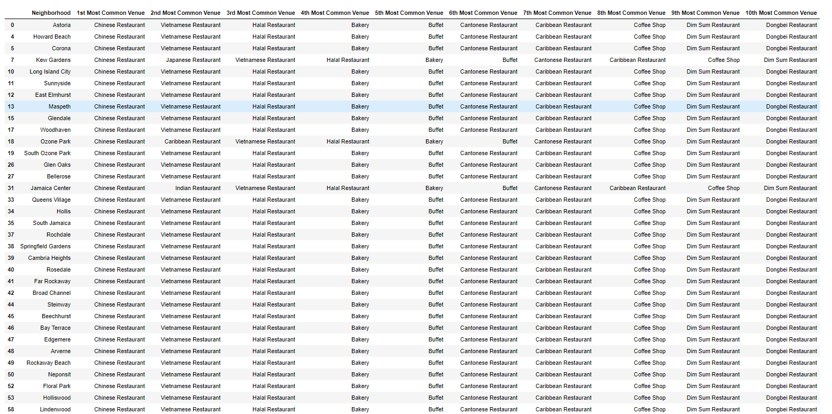
Cluster 1
Then use this function to group the neighborhoods into clusters, and use the K-means clustering algorithm to complete this task. In addition, the Folium library can also visualize the communities in Queens and its emerging clusters.

Slide 9
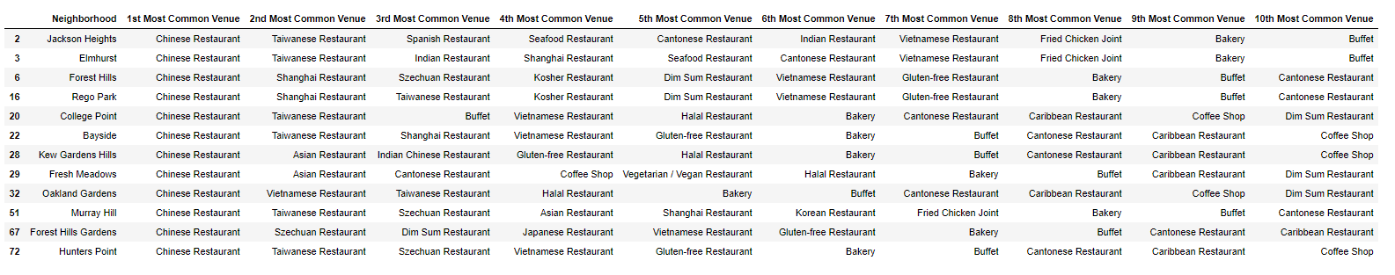
Cluster 2 and 3
Then use this function to group the neighborhoods into clusters, and use the K-means clustering algorithm to complete this task. In addition, the Folium library can also visualize the communities in Queens and its emerging clusters.

Slide 10
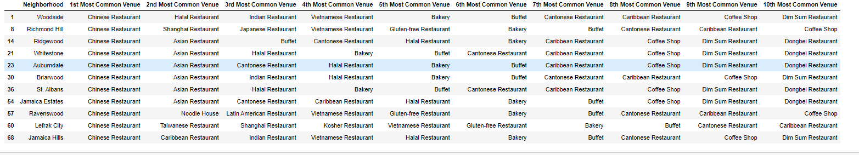
Cluster 4
Then use this function to group the neighborhoods into clusters, and use the K-means clustering algorithm to complete this task. In addition, the Folium library can also visualize the communities in Queens and its emerging clusters.

Slide 11
Result
After the project, We got the conclusion, The cluster 3 will be the best position to have the restaurant

Slide 12
Discussion and conclusion
All the result could be works for limited data but not for a large and unstable one. The result reflects that it could be correct or not. Which is unstable. There are a lot of area might be good for the restaurant but the analyst result is not include. Which means it might be not reliable. It need people to double check could be the best way after the data analyse. It can only provide some of position as recommend and the truth should be explore by real people.

